Slide 1
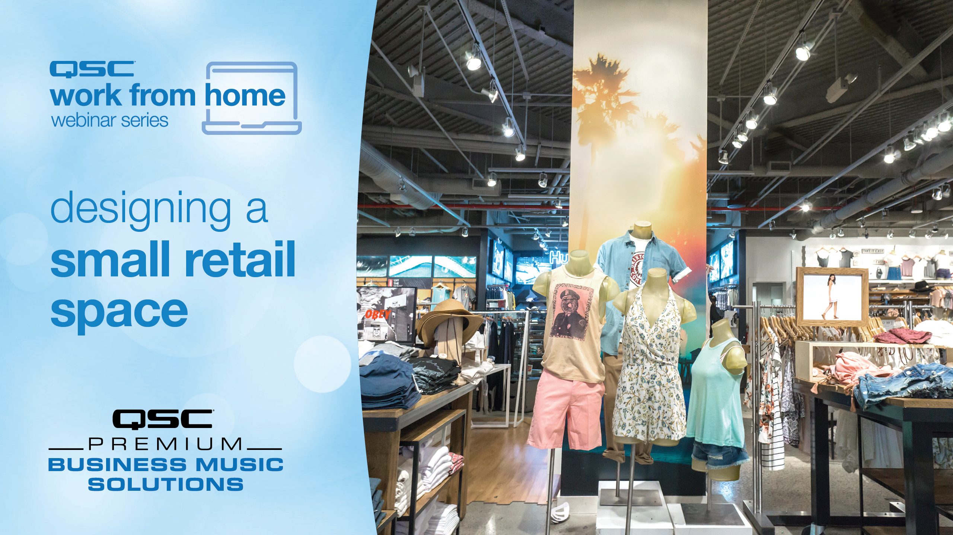
Notes:
QSC has some great solutions for Business Music Applications
Business Music is kind of a catch-all category that includes Restaurants, Retail Stores, Gyms and Fitness studios, Aquatic Centers, Common Areas for Community of Retirement Centers, basically any applications where audio is necessary and is part of the system, but is perhaps not the primary focus of the system or application.

Slide 2
rules of engagement
Ask questions throughout the webinar!
  Please put your questions in the Q&A Section, not the chat window
  If a question is unable to be answered during this session a QSC team member will respond directly via email (as long as the question is not asked anonymously)
VoiP is enabled for those who wish to ask a live question!
  To do so, please raise your hand and the host will unmute your microphone

Slide 3
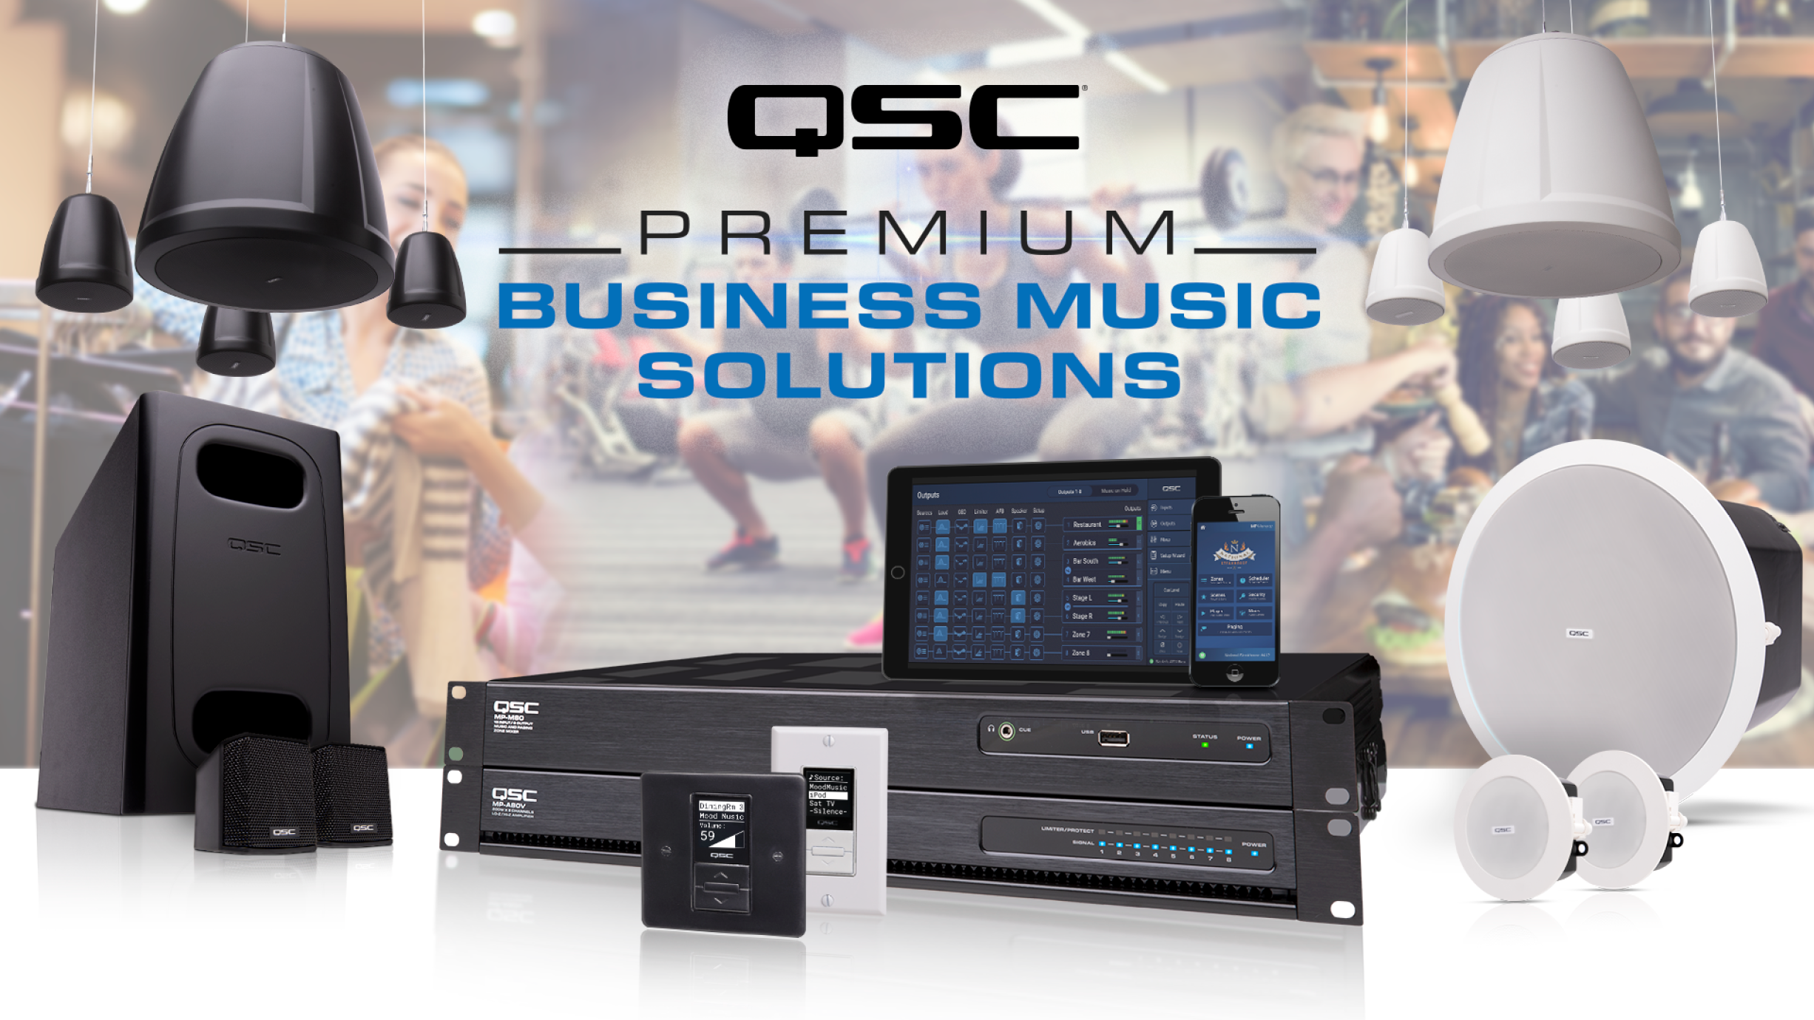
Notes:
Global background music market in hospitality sector
The hospitality sector was the highest consumer of background music in 2016. The hospitality sector relies on background music to set up the mood and ambiance for customers. Most of the cafes, restaurants, and hotels use low tempo classical music to enhance customer experience and encourage them to spend more time at these places. This segment is likely to exhibit growth during the forecast period owing to the growing number of restaurants, hotels, and cafes.
Global background music market in retail sector
The retail sector includes retail outlets, showrooms, and departmental stores. Background music plays an important role in influencing the buying decisions of customers. Different genres of background music are used depending on the type of retail outlet. For instance, Abercrombie & Fitch uses loud music to define their brand that sells vibrant casual wear for the younger generation. Barnes & Noble uses slow and relaxing music.
Retailers decide the type of background music based on the target audience and types of products that are sold. High tempo music is played in stores with a high footfall to encourage customers to shop quickly. In contrast, stores with a niche audience use low tempo music to help customers relax and allow them to make purchase decisions easily, says Ujjwal Doshi, a lead analyst at Technavio for media and entertainment services research.
Global background music market in commercial buildings
With the growth in commercialization, there has been a significant increase in the construction of tall buildings with elevators to fulfill the need for office and residential space. The construction industry is shifting its focus toward the construction of high-rise buildings owing to the limited land availability and growing population. This is expected to increase the demand for background music as it is used to entertain individuals that use elevators in high-rise buildings.
“Furthermore, the shopping behavior of customers has changed in the past decade. Customers have shifted from shopping in single stores to multi-brand retail outlets and shopping malls. Background music subconsciously influences the purchasing decisions of consumers. Ambient music is used in shopping malls, retail outlets, office lobbies, and elevators,” says Ujjwal

Slide 4
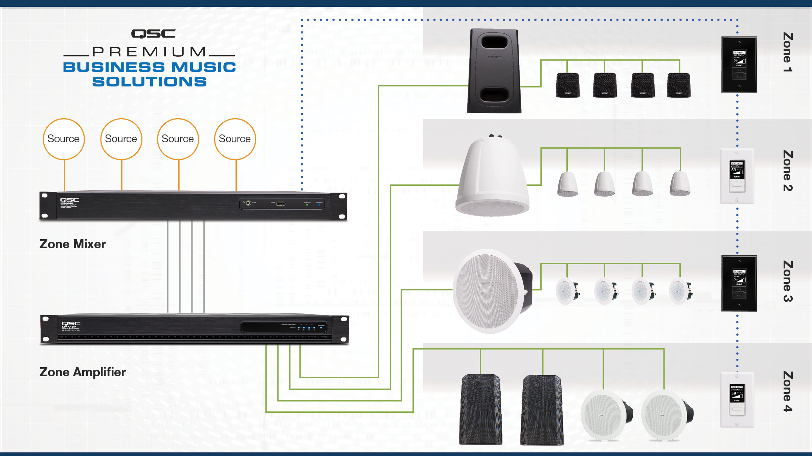
Notes:
A couple of years ago we developed a complete set of products for these applications and we continue to add to them. We have some great loudspeakers, including Sub/Sat solutions, some amazing flexible amplifiers, and an affordable DSP processing solution that provides convenient control and all the necessary processing.

Slide 5
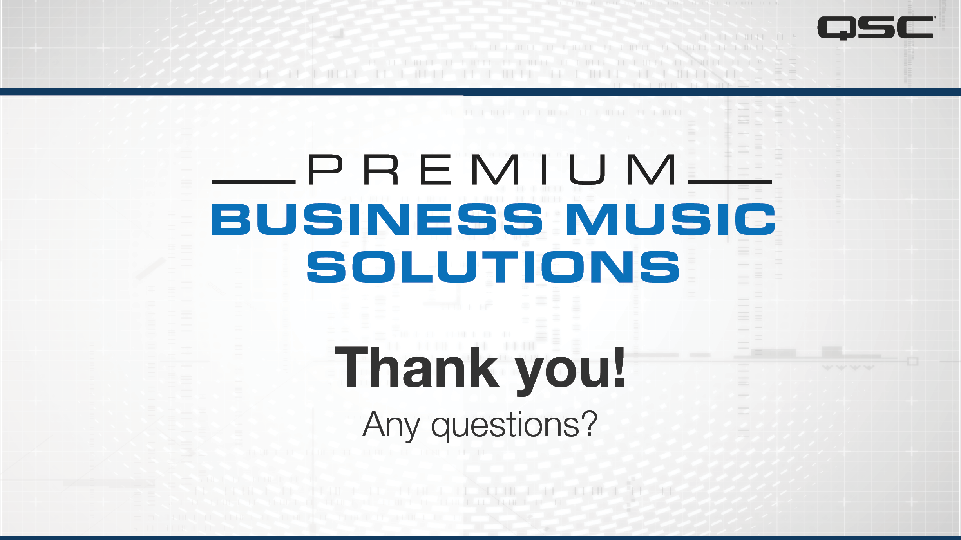
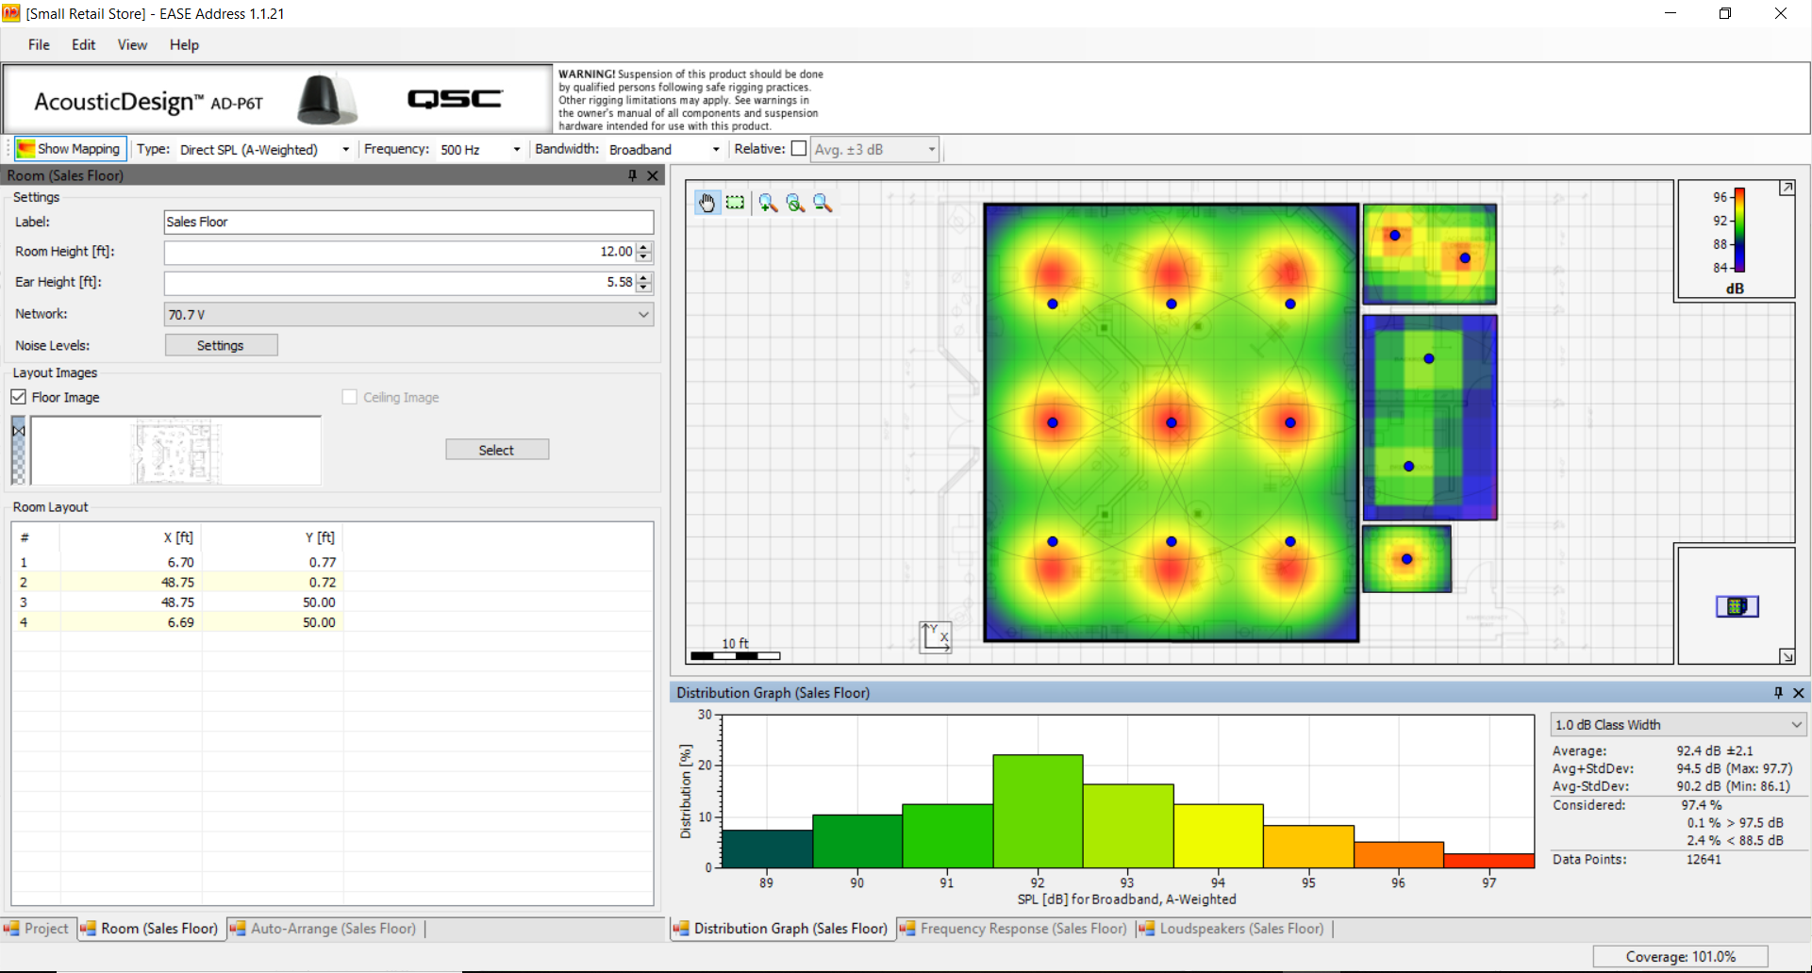
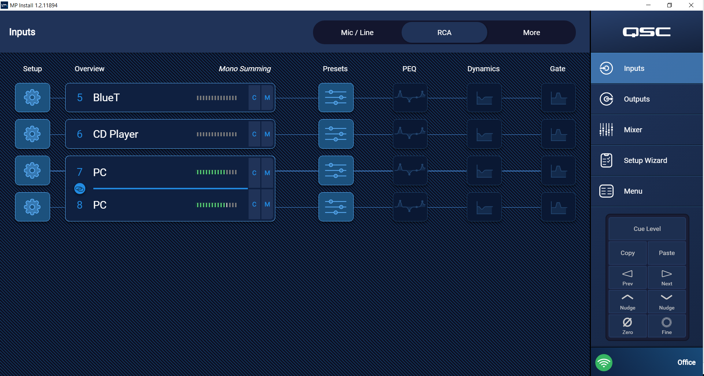
Creating a Business Music System for Retail
Tools
EASE Address software
QSC MP Install software
Notes:
During today’s seminar/webinar we’ll be using two software applications (EASE Address and MP Install), and while we will not have time to delve too deeply, we will see some of the basics of how to use these programs.

Slide 6
Creating a Business Music System for Retail
Process
Determine Customer Expectations
Design Space / Create Zones
Choose Speakers
Design Speaker Layout / Choose Amps
Program the System Processor*
Installation / Commissioning
* Programming the system configuration “off-line” will help in speeding the integration process, but there will still be programming that needs to happen once you get on-site and are commissioning the system.
Notes:
The design process can be broken into six basic steps, each is unique and is really required.
1) The first is in many ways the most important – you must find out from the customer what their expectations are.
2) Once you know the what the requirements are, you can break the space into various zones.
3) Your third step is to choose the loudspeakers that will be used in each of the zones.
4) Once the speakers are selected you’ve got to lay out the space and place the speakers (virtually) into it. Selecting loudspeakers and placing them in the space provides the data you need to approximate the power required and choose amplifiers.
5 / 6) At this point you can begin to program the processor. I say begin because the programming process will really extend into the installation and commissioning of the venue.

Slide 7
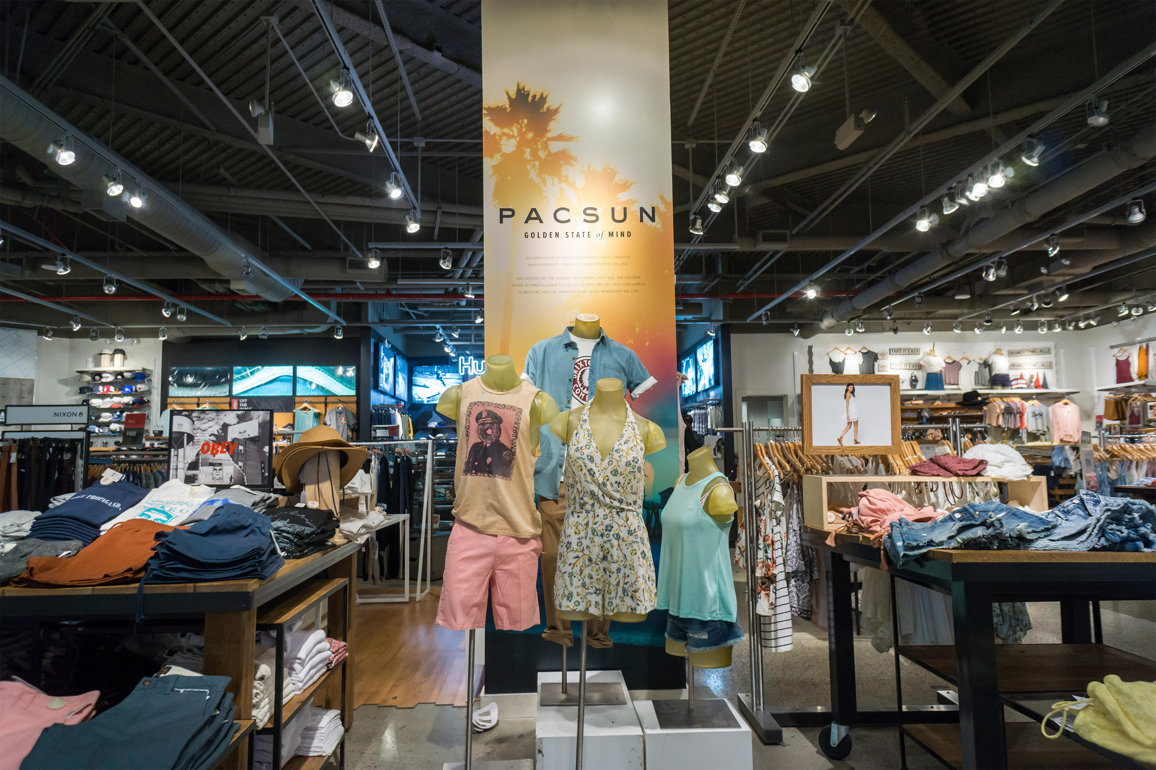
Step 1 – Customer Expectations
Pac Sun Retail Space
Mid-Energy Background Music
Open ceiling except for the back areas.
Want limited wall control of the system from sales counter and office.

Slide 8
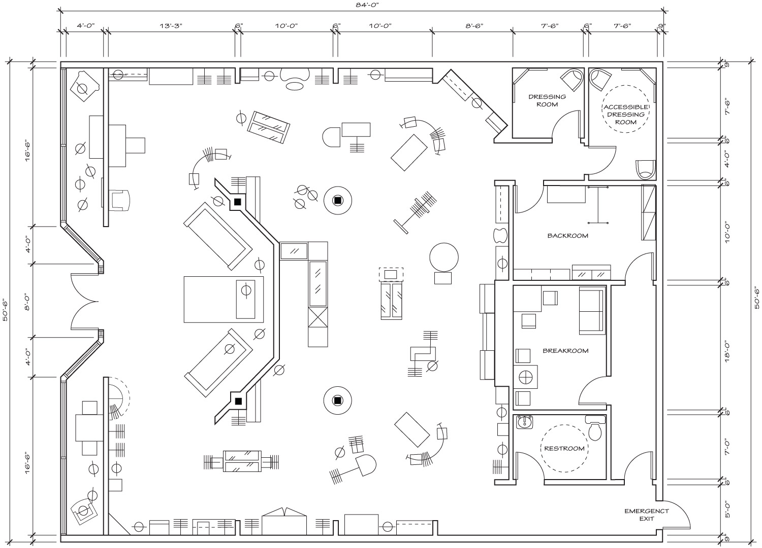
Step 2 – Design Space / Create Zones
Pac Sun Retail Space
Mid-Energy Background Music
Four zones:
  Sales Floor
  Offices
  Bathroom
  Dressing Rooms

Slide 9
Step 2 – Design Space / Create Zones
Pac Sun Zones
Sales Floor - 43ft x 50ft, Open Ceiling
Sales Floor: Height = 12 feet

Slide 10
Step 2 – Design Space / Create Zones
Pac Sun Zones
Sales Floor
Dressing Rooms – 15ft x 12ft, Sheetrock Ceiling,
Dressing Rooms: Height = 10 feet

Slide 11
Step 2 – Design Space / Create Zones
Pac Sun Zones
Sales Floor
Dressing Rooms
Break Room / Office – 15ft x 28ft, ceiling tile
Back Rooms: Height = 10 feet

Slide 12
Step 2 – Design Space / Create Zones
Pac Sun Zones
Sales Floor
Dressing Rooms
Break Rooms
Bathroom – 9ft x 7ft, Sheetrock ceiling
Bathroom: Height = 10 feet

Slide 13
Step 3 – Choose Speakers
Considerations
Ambient Noise
Volume Level
Ceiling Height
Coverage density
Speaker Type
Loading
Dressing
Rooms
Sales Floor
Back
Rooms
Bathroom
Notes:
Some of the considerations that you should think about when you choose loudspeakers:
The ambient noise level – this is actually very important
The volume level that this system will be playing at
The ceiling height is obviously critical, especially with ceiling and pendant speakers, as it will directly effect the speakers needed, and the power necessary to drive these speakers
How dense the speaker coverage is
And finally the speaker loading – whether these are running in low-Z mode or 70V mode

Slide 14
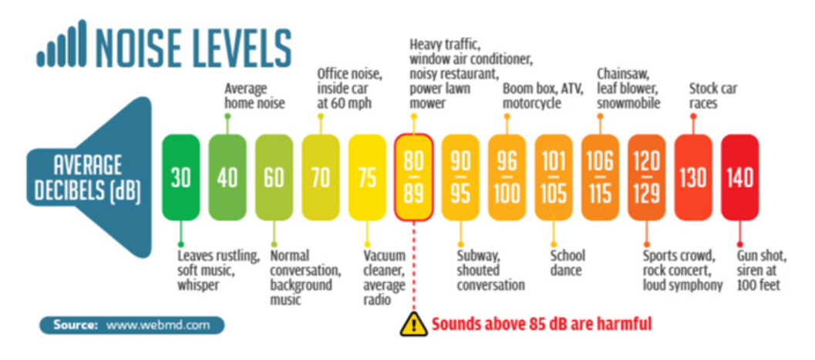
Step 3 – Choose Speakers
Considerations
Ambient Noise
Volume Level
Ceiling Height
Coverage density
Speaker Type
Loading
Notes:
To further drill into this the Ambient Noise and the Volume Level in the store are critically important. You can see from this chart that typical ambient noise is somewhere in the neighborhood of 50 to 60 dB SPL depending on where you are. Which means that you probably want the Background Music somewhere between 6 dB to 10 dB above the ambient. If the content is intended to be Foreground Music then you want it at a much higher level – something where you need to talk over it – probably in the neighborhood of 80 to 90 dB SPL.
These two levels will likely require two different types of speakers, and will also likely require different speaker densities.

Slide 15
Step 3 – Choose Speakers: AD-P/C Series
Zones
Sales Floor – AD-P6T
Dressing Rooms – AD-C6T
Break Rooms – AD-C6T
Bathroom – AD-C6T
DESIGNED TO MIX AND MATCH
Notes:
The Acoustic Design series loudspeakers sound great and all the models are designed to work together from the 4” ceiling speakers to our fantastic sounding 6” pendant, all the way up to the 10” and 12” surface mount speakers.

Slide 16
Step 4 – Design Speaker Layout
Considerations
Ambient Noise
Volume Level
Ceiling Height
Coverage density
Speaker Type
Loading
Dressing
Rooms
Sales Floor
Back
Rooms
EASE Address
Bathroom

Slide 17
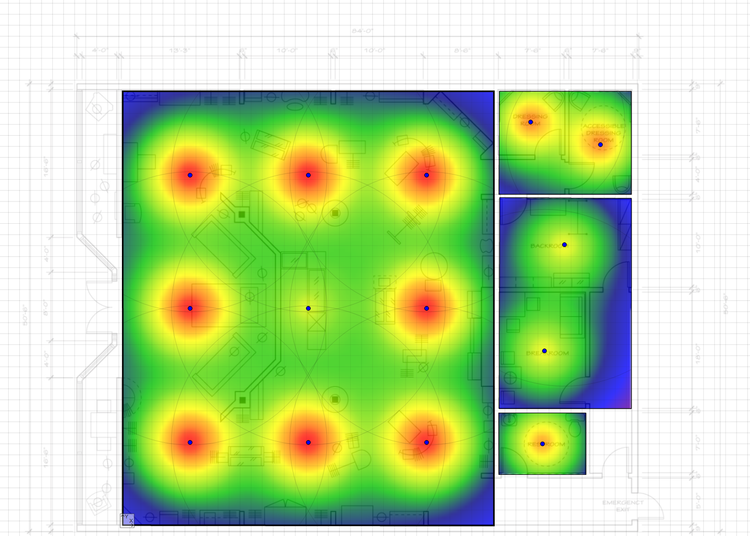
Step 4a – Design Speaker Layout
Zones
Sales Floor – (9) AD-P6T
Dressing Rooms – (2) AD-C6T
Break Rooms – (2) AD-C6T
Bathroom – (1) AD-C6T
Dressing
Rooms
Sales Floor
Back
Rooms
Bathroom
Notes:
So after going to EASE Address I’ve got this layout. One thing to notice is that I lowered the tap setting on the speaker that is in the center of the sales area because it is close to the Cash and Wrap and I don’t want the employees have to struggle to talk over the audio system.
I could have gone to some other speakers from the AD series, but it was just easy to choose the 6” pendant and ceiling speakers to keep the system sounding as similar as possible.

Slide 18
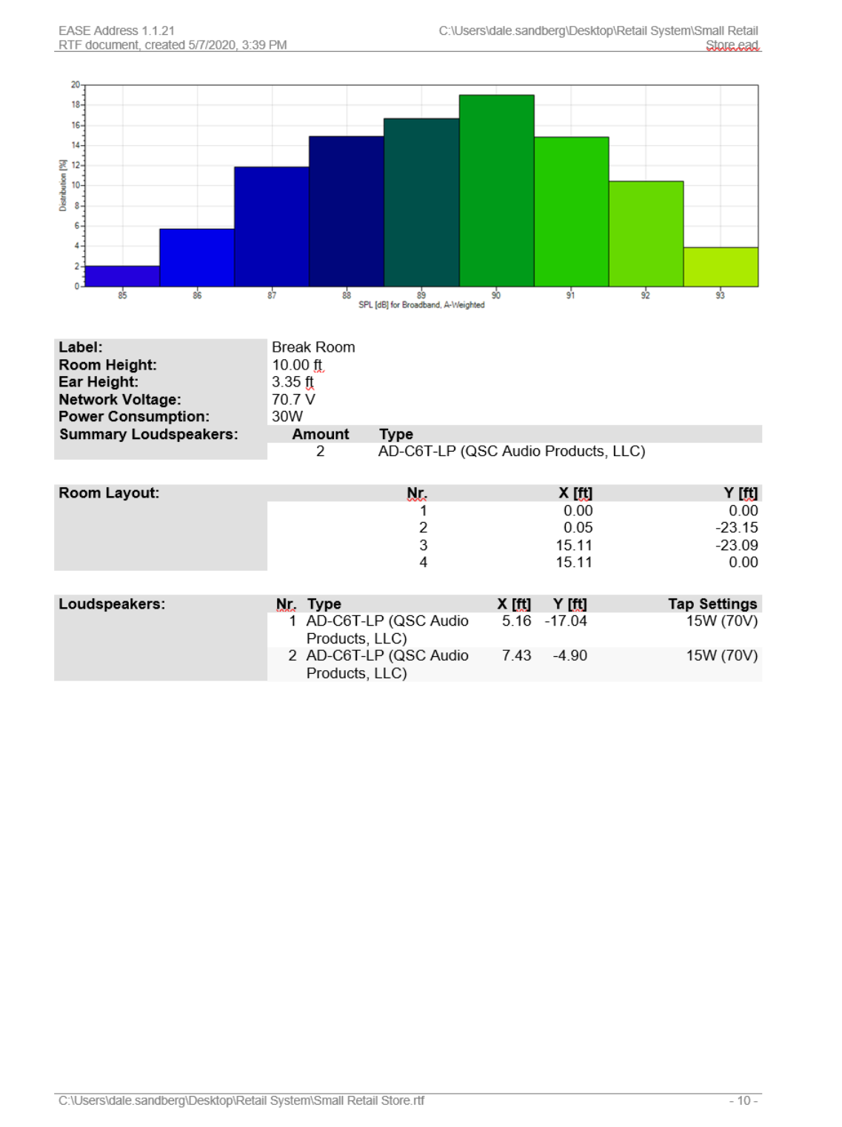
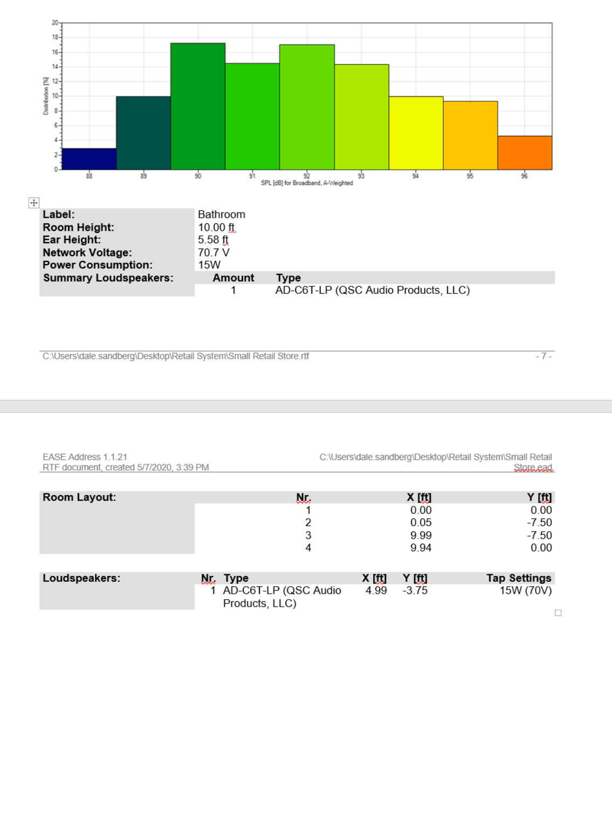
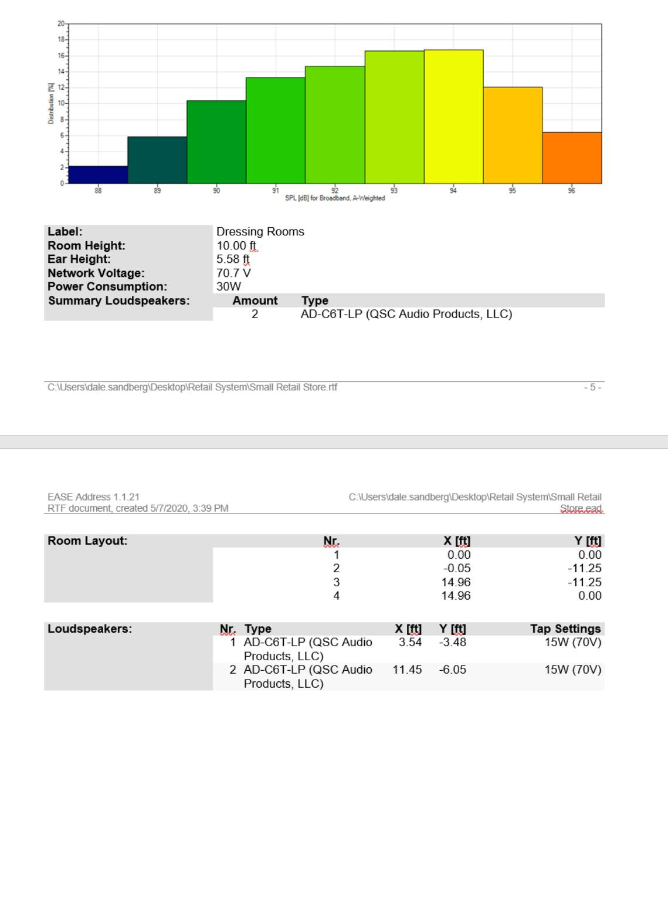
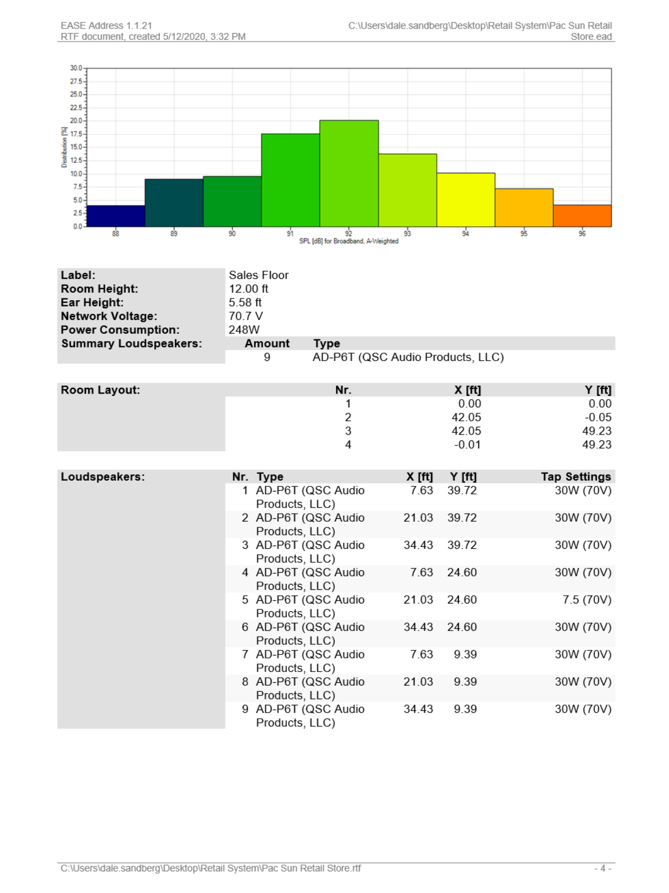
Step 4b – Choose Amps
Zones
Sales Floor – 248 Watts
Dressing Rooms – 30 Watts
Break Rooms – 30 Watts
Bathroom – 15 Watts

Slide 19
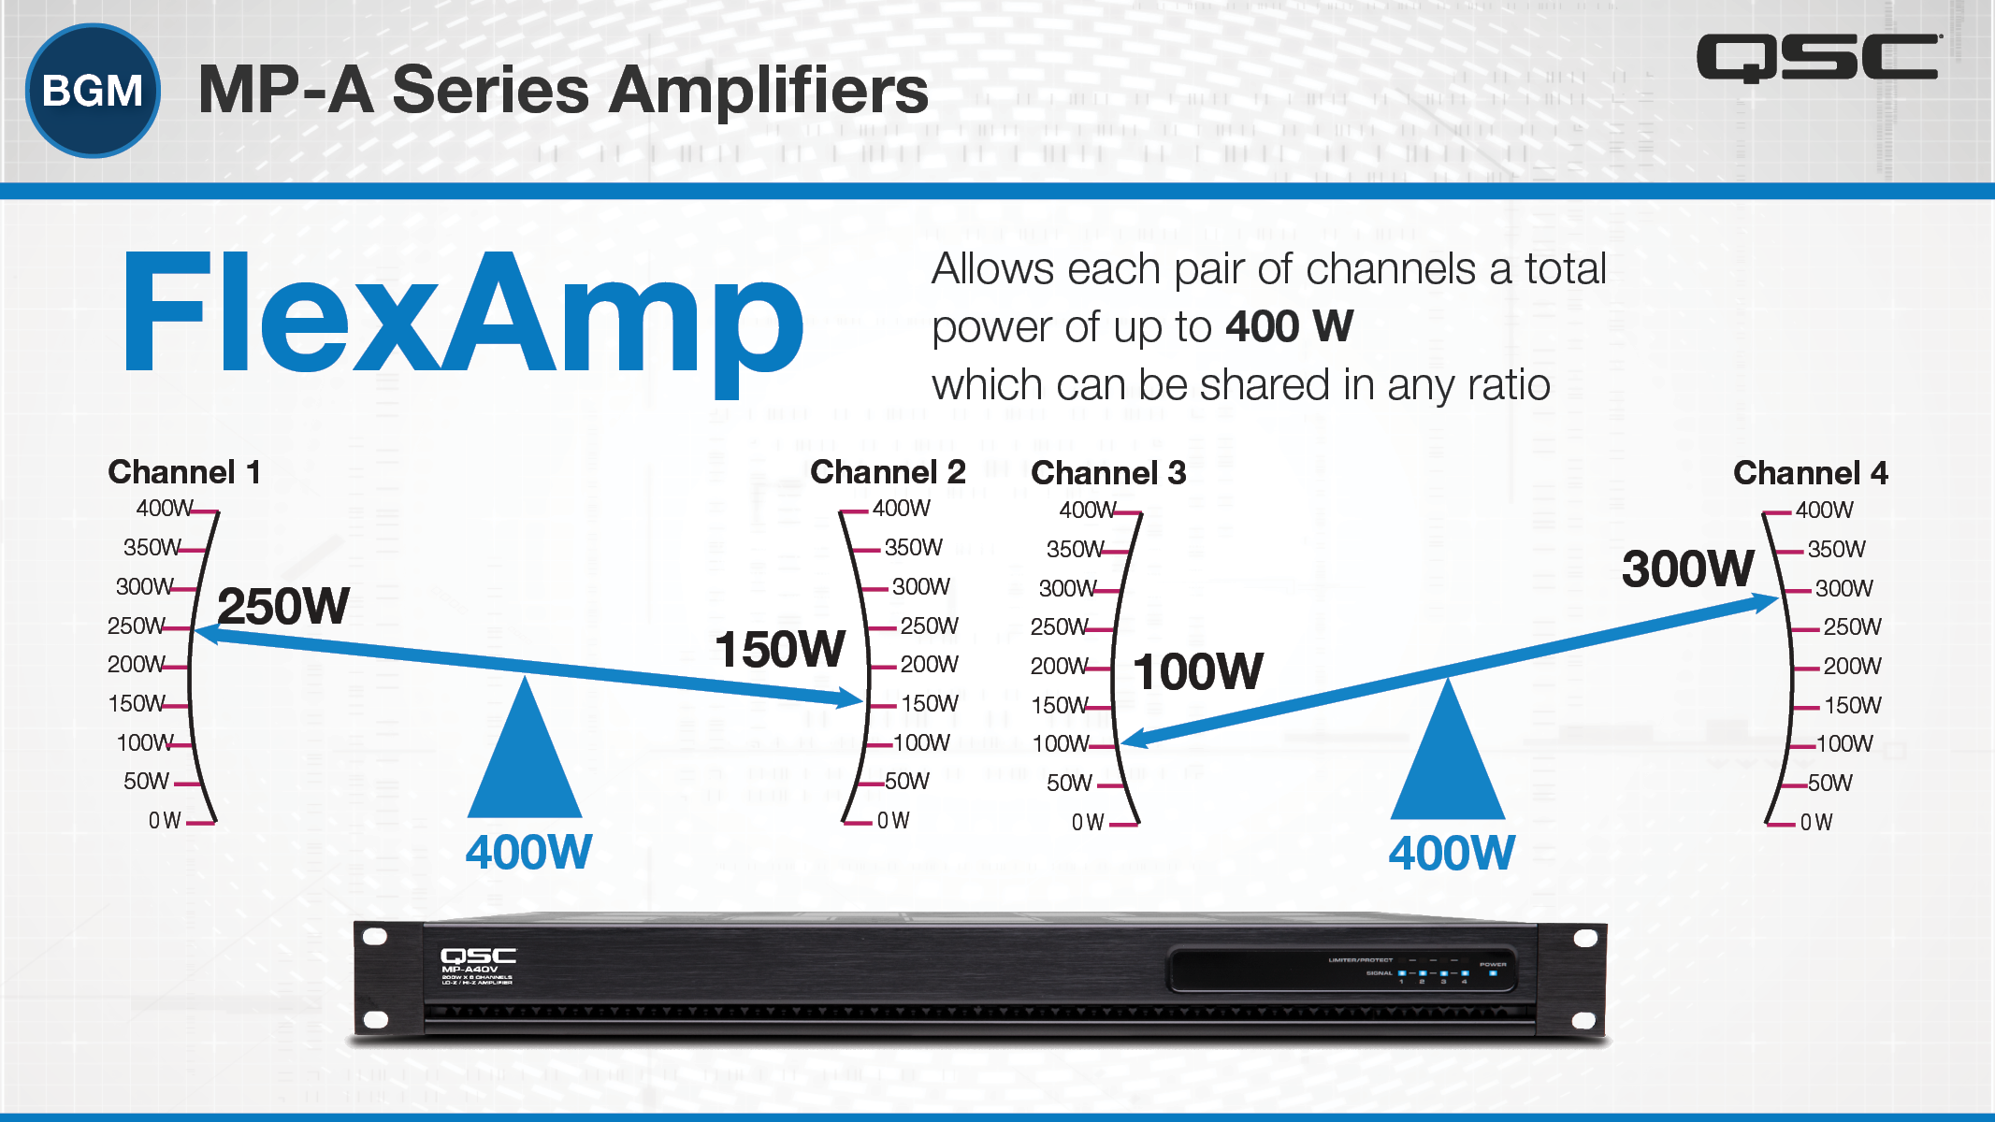
Step 4b – Choose Amps: MP-A Series

Slide 20
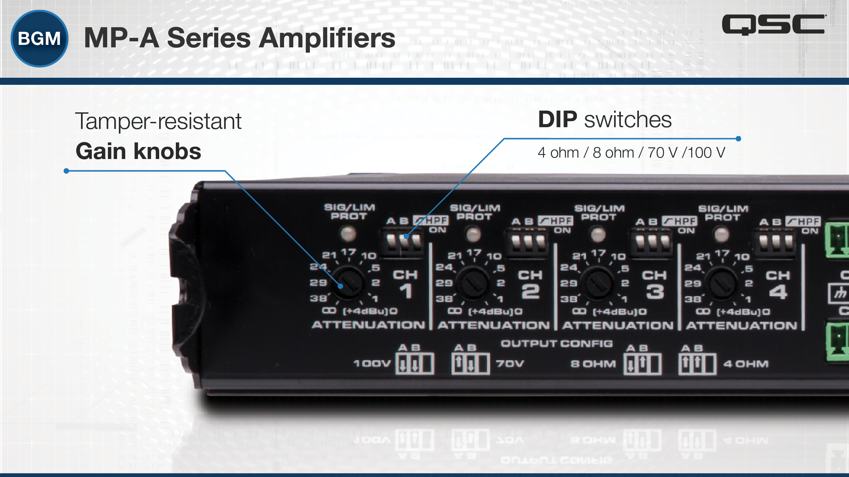
Step 4b – Choose Amps: MP-A Series

Slide 21
Step 5 – Program Processor
Programming Considerations
Input Signals
  BGM Content
  Phone Input
Output Zones & Speakers
Control Types & Locations
Dressing
Rooms
Sales Floor
Back
Rooms
Bathroom

Slide 22
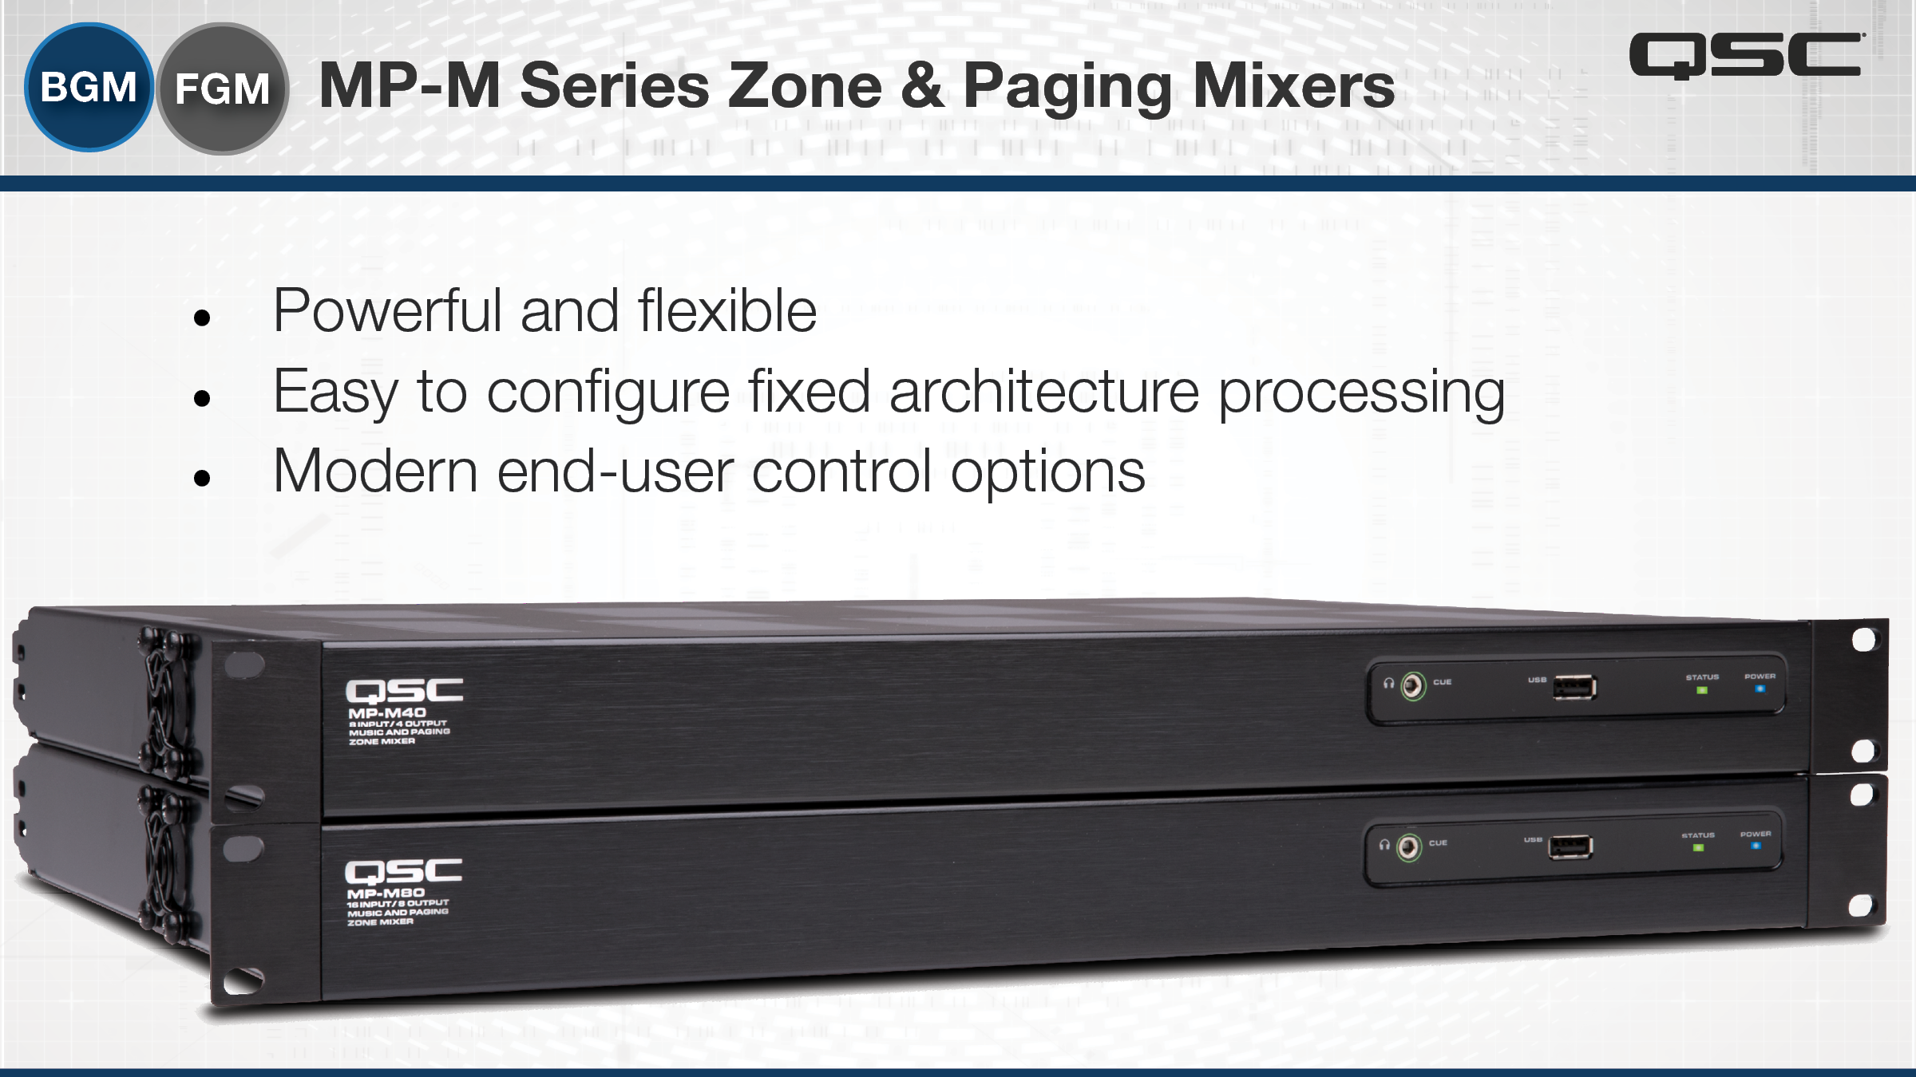
Step 5 – Program Processor: MP-M Series

Slide 23
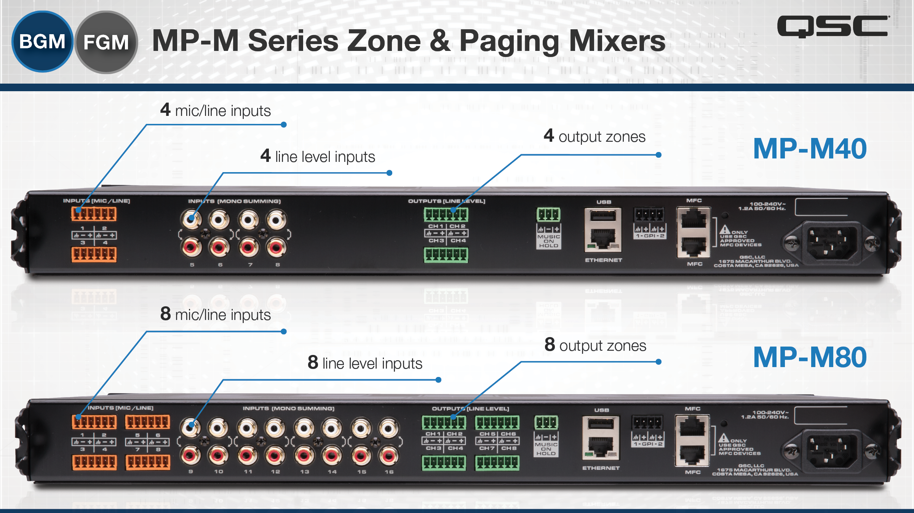
Step 5 – Program Processor: MP-M Series
Notes:
AAUDIO RELATED
At the heart of the series are two MP-M mixer processors that differ only in regard to input and output channel count.
The MP-M80 has eight mic/line inputs, eight line inputs and eight zone outputs while the MP-M40 has four mic/line inputs, four line inputs and four zone outputs. Each line input features dual phono-jacks (summed to mono) for easy connection to the sources typically found in business music installations.

Slide 24
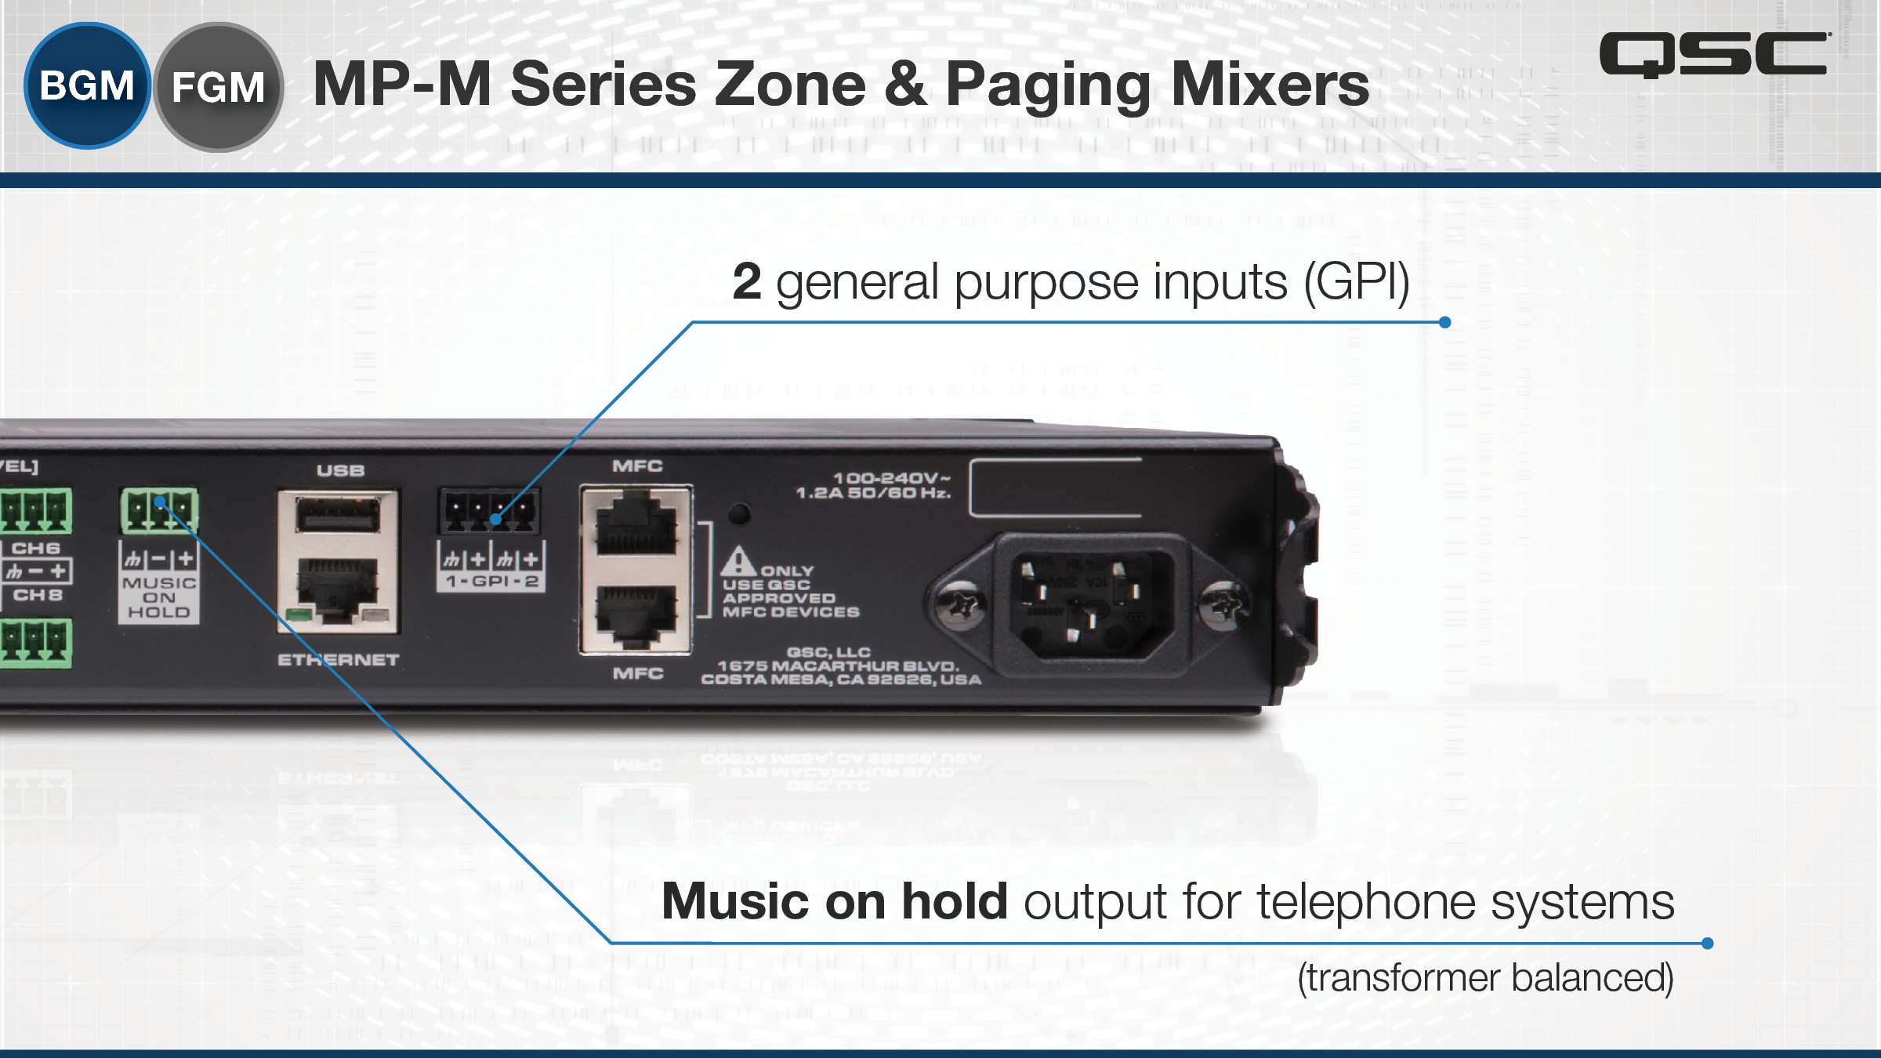
Step 5 – Program Processor: MP-M Series

Slide 25
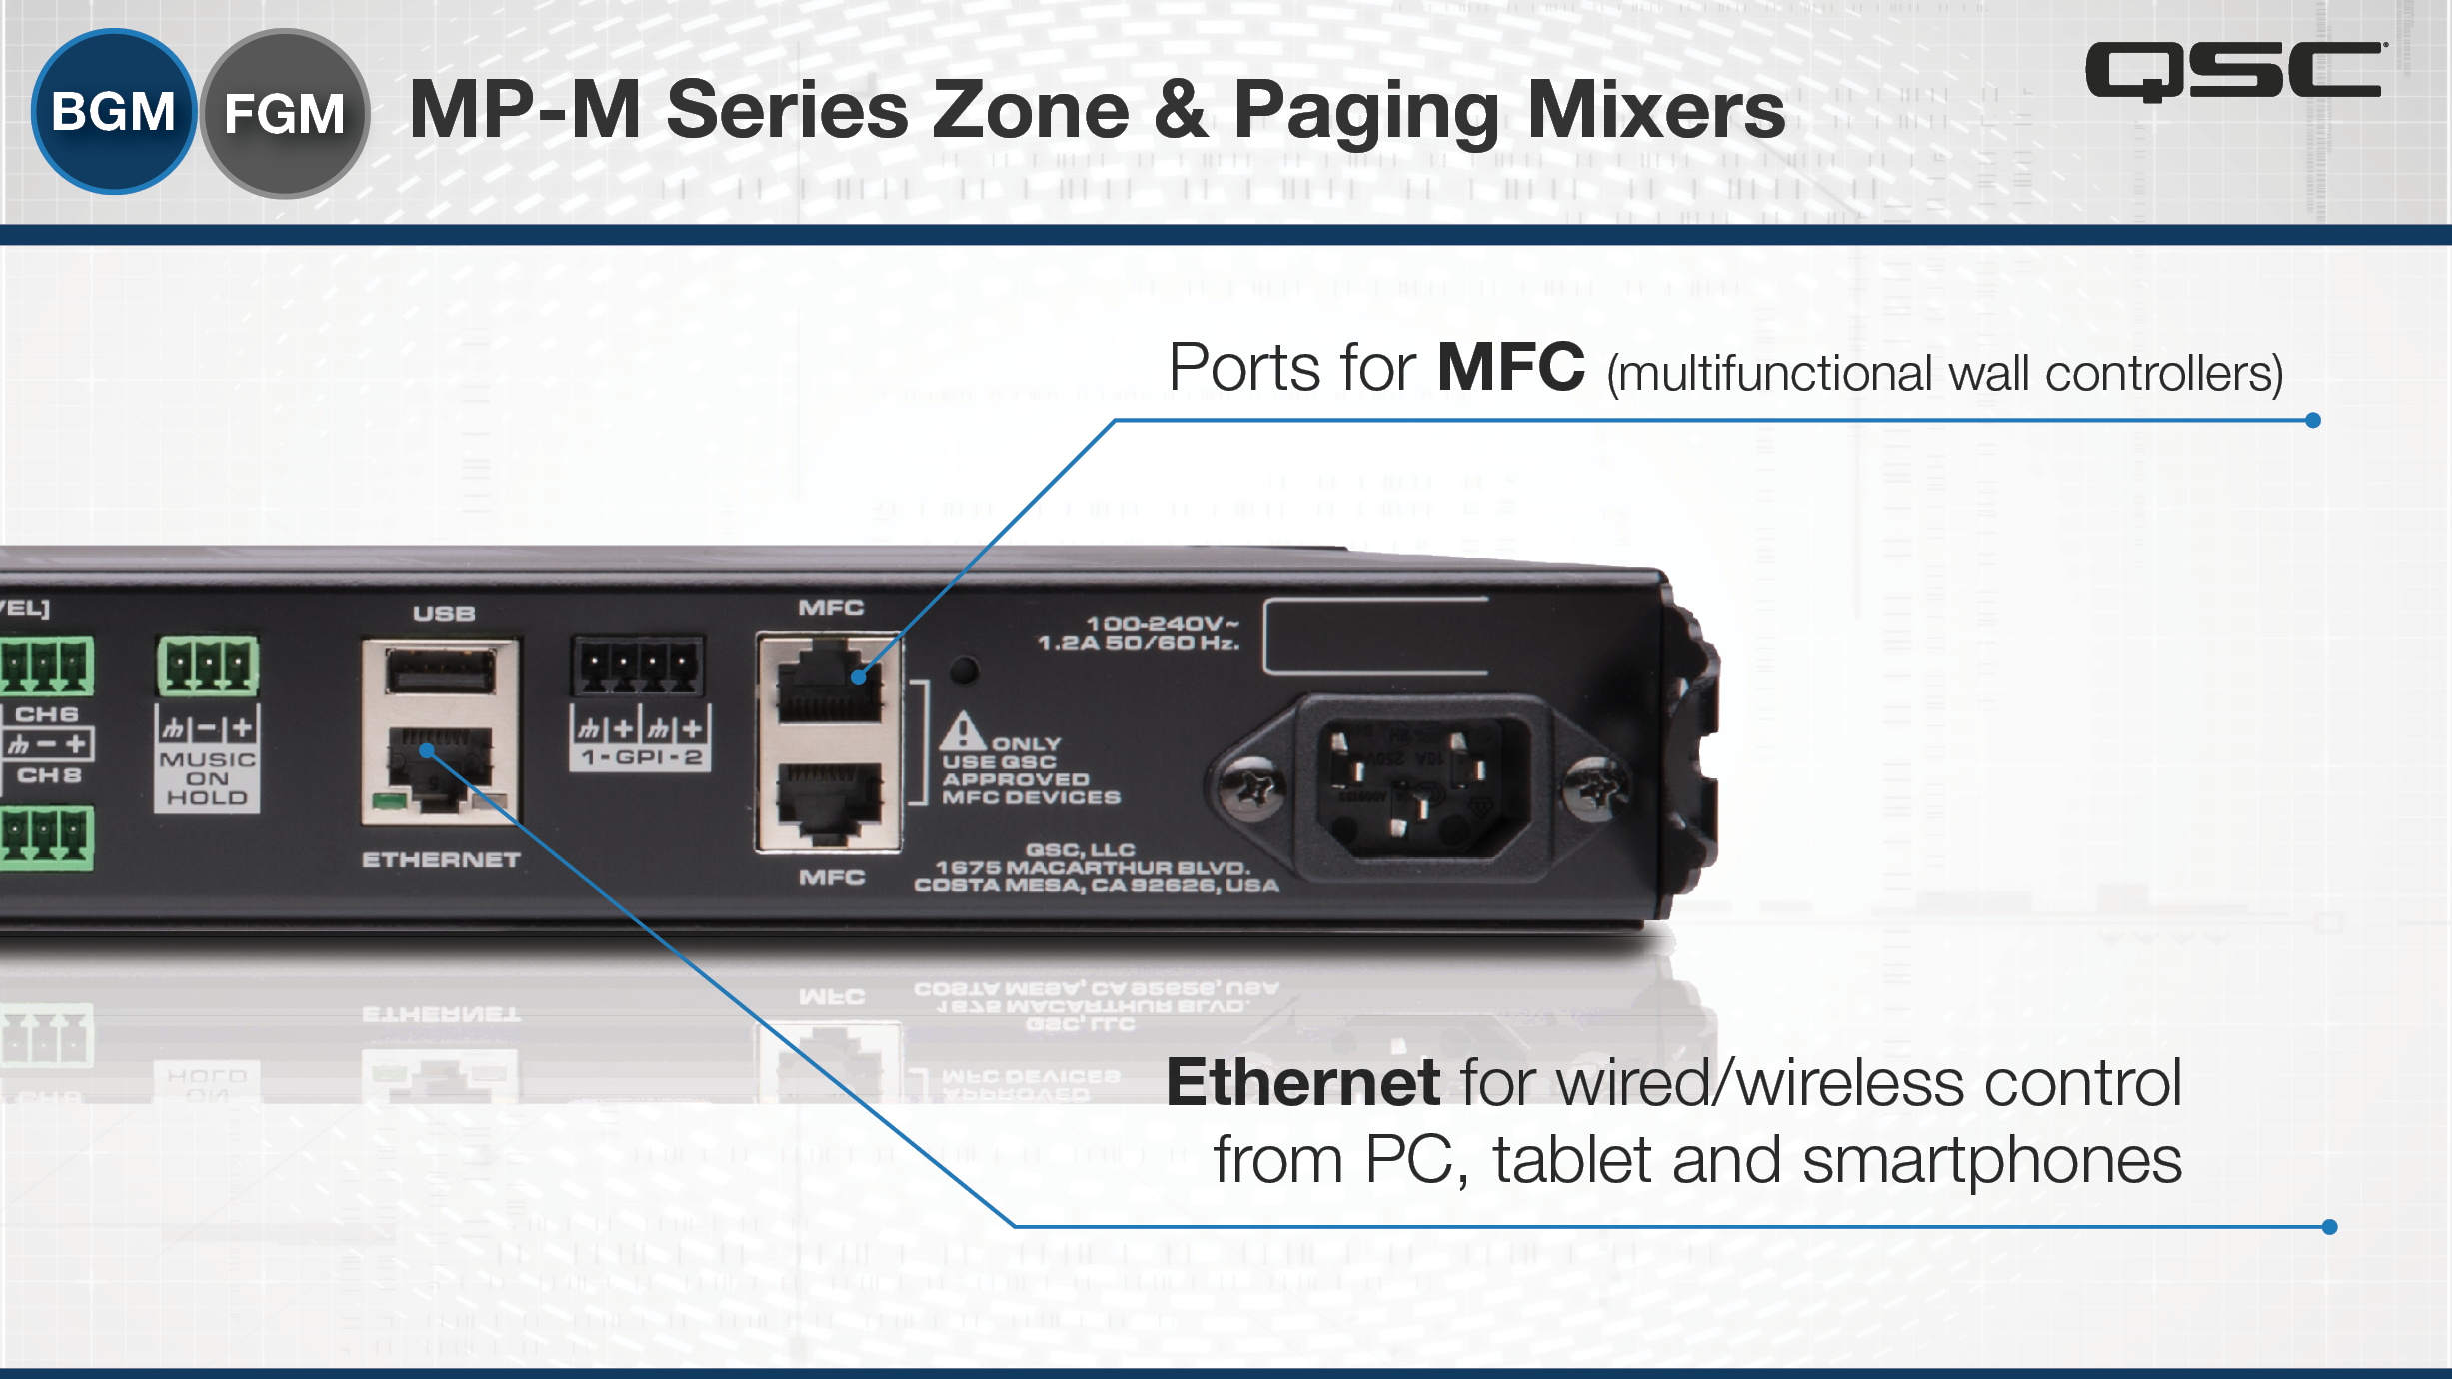
Step 5 – Program Processor: MP-M Series

Slide 26
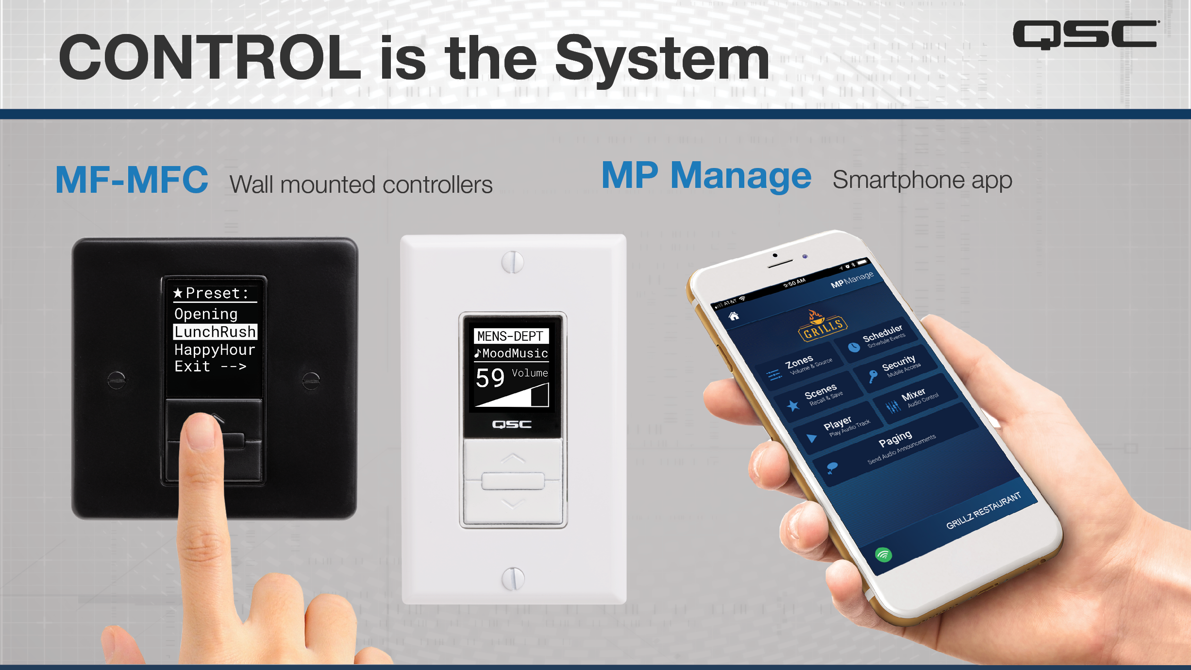

MP-MFC
MP Manage
Notes:
To your customer, the control is the system and the MP-M offers flexible and powerful control options that let you give your clients as much or as little control as they need or can handle.
MFC controllers feature a graphic display so functions are clearly labelled and displayed. The controllers are easily configured to control source selection and level for one or more zones as well as recalling scenes.
MP Manage is a free app for use by facility staff for day-to-day operation of basic system functions.

Slide 27
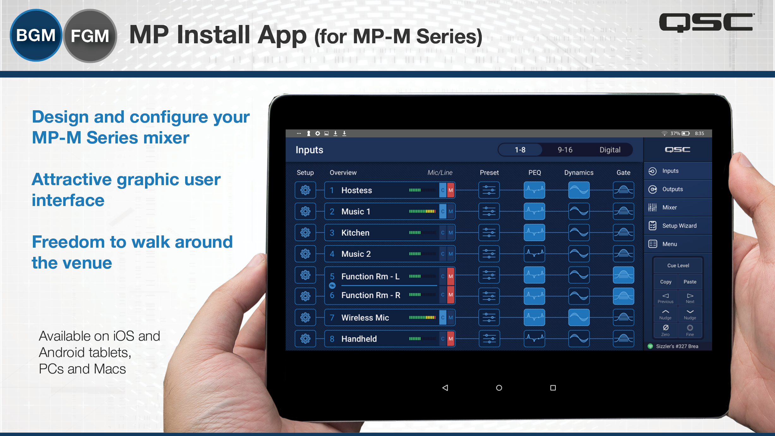
Step 5 – Program Processor
Notes:
MP Install is used by the system designer and installer to configure and tune the system. The app runs on iOS and Android tablets as well as Windows computers. Offline and online use is supported allowing the designer to pre-configure a system without connecting to actual MP-M hardware. All MP-M parameters and settings are accessible from the app which also includes a number of wizards and tools to assist the installer with system tuning and commissioning.

Slide 28
Step 6 – Installation & Commissioning
Set Up
Input Signals
  BGM Content
  Phone Input
Output Zones & Speakers
Control Types & Locations
Dressing
Rooms
Sales Floor
Back
Rooms
Bathroom
Notes:
Things to do during the installation process. Connect the Inputs and Outputs. Wire the loudspeakers and make sure the tap settings are correct. Wire the CAT5 for the MFC controllers. Make sure Inputs are getting to Outputs and make sure the speakers sound the way they are supposed to.

Slide 29
Step 6 – Installation & Commissioning
Surprise!!
Obstruction above the ceiling in the Dressing Rooms and Bathroom.
Replace speakers with AD-C4T-LP
LOW-PROFILE
Notes:
Surprise – during the installation you run up against an obstruction in the ceiling of the Bathroom and the Dressing rooms. It is actually not that uncommon to run into something like this during the installation. So instead of keeping the 6” speakers in those areas I went to the 4” low-profile speakers which use the exact same cut-out as the standard 6” ceiling speakers. Because they are still part of the Acoustic Design family they will still sound very similar - they have a family sound.

Slide 30
Step 6 – Installation & Commissioning
Zone Control
Sales Floor – one MFC controller behind the cash register
Office – one MFC controller in the office
Dressing
Rooms
Dressing
Rooms
Sales Floor
Sales Floor
Back
Rooms
Back
Rooms
Bathroom
Bathroom
Notes:
As you program for the wall controllers in the office and behind the sales counter it is as simple as selecting the proper options and pressing the PAIR button, then pressing any button on the MFC wall controllers.

Slide 31
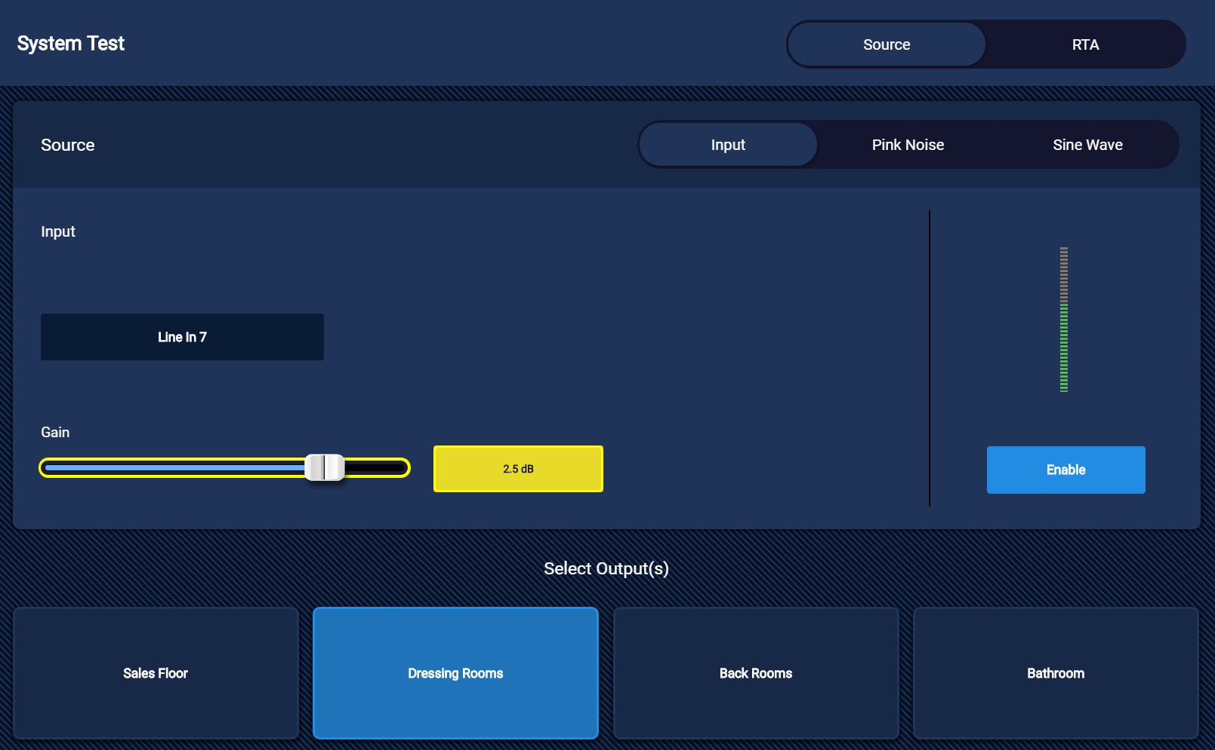
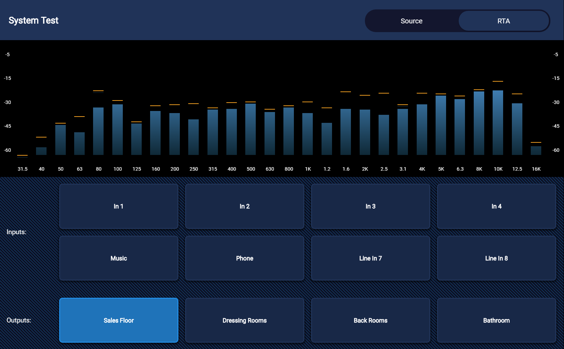
Step 6 – Installation & Commissioning
System Tuning
Make sure correct speaker tunings are chosen for each zone.
Select Source for each zone.
Use RTA

Slide 32
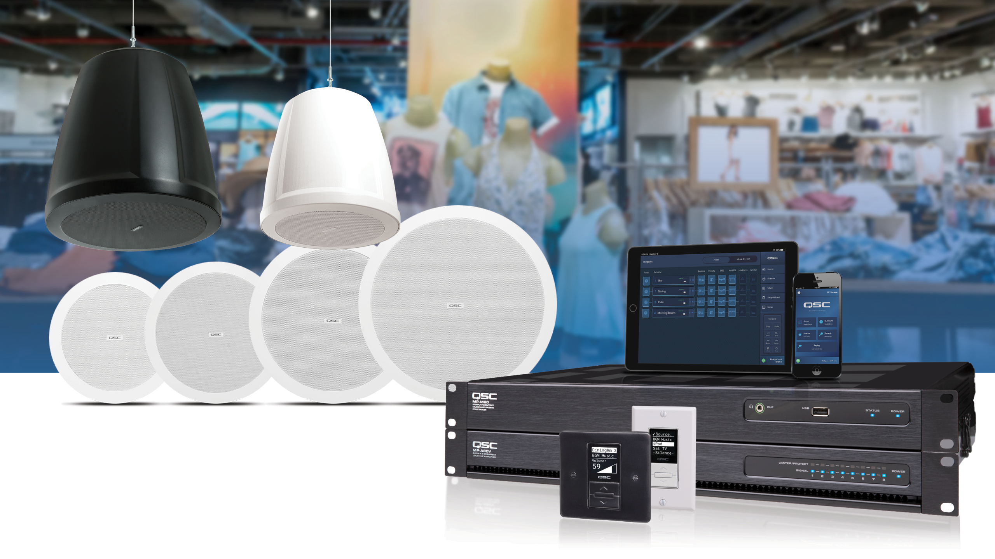
System Design & Installation Complete!

